Slide 1

SIDDAGANGA INSTITUTE OF TECHNOLOGY
(Autonomous institute, affiliated to VTU, Belgaum, Recognized by AICTE, Accredited by National Board of accreditation,New Delhi)
DEPARTMENT OF ELECTRONICS AND TELECOMMUNICATION ENGINEERING
MINI PROJECT PHASE-2 PRESENTATION
ON
“ENHANCEMENT OF ANCIENT MANUSCRIPTS USING IMAGE PROCESSING TECHNIQUES”
By:
KOWSHIK KEERTHANA
JANHAVI H
MOULYA D
SHILPA S P
Under the guidance of:
Dr. K. VISWANATH
Professor, Department of ETE
S.I.T Tumkur
1SI19ET017
1SI19ET014
1SI19ET020
1SI19ET034

Slide 2
INTRODUCTION
Historical documents related to art and architecture, mathematics, law, music and medicine, written around several hundreds of years are still available for reference today which is preserved by libraries and universities.
Generally, there are two types of deficiencies in the quality of historical document images. First, the original paper document is aged leading to deterioration. The second problem is introduced during conversion of the documents to their digital image form.
The problem of uneven background color intensity across an image is often seen in historical document images.
Due to the above deficiencies, the document image background together with the foreground handwritten text are fluctuating. The separation of text from the paper background is often unclear.

Slide 3
LITERATURE SURVEY
SL NO | TITLE | AUTHOR | YEAR | METHODOLOGY | METHOD TO BE USED IN THIS WORK
1 | Image Restoration of Historical Manuscripts | Ketki R.Ingloe and V.K.Shandilya | 2011 | Enhances methodology permitsthe improvement of the quality of historical Arabic manuscripts, which presented uneven background, low contrast and the effect of aging and degradation by image normalization. | K-means Algorithm
2 | Enhancement of Old Manuscript Images | Avekash Gupta, Sunil Kumar, Rajat Gupta, Santanu Chaudhury, Shiv Dutt Joshi | 2007 | a novel technique for locating and enhancing low contrast regions in old scanned manuscript images. It is based on a matched wavelet-based text extraction algorithm followed by MRF post-processing | Background segmentation

Slide 4
LITERATURE SURVEY
SL.NO | TITLE | AUTHOR | YEAR | METHODOLOGY | METHOD TO BE USED IN THIS WORK
3 | Review on Image Enhancement Methods of Old Manuscript with Damaged Background | Sitti Rachmawati Yahya , S. N. H. Sheikh Abdullah , K. Omar , M. S. Zakaria, and C. -Y. Liong | 2009 | This method changes the whole image color from colored image to grayscale, to ease the subsequent processes. Then, the grayscale image is transformed into a binary image using the thresholding process. | Histogram Normalization
4 | Digital Image Enhancement using Normalization Techniques and their application to Palm Leaf Manuscripts | Zhixin Shi and Srirangaraj Setlur, Venu Govindaraju | 2005 | a set of transform-based methods for enhancing digital images of palm leaf manuscripts by approximate the background of a grayscale image using one of two models . | Background Normalization

Slide 5
OBJECTIVES
To improve the quality of historical manuscripts having an uneven background and low contrast due to the effect of aging and degradation.
To apply a background normalization algorithm that smoothens out the background.
To compare the image processing enhancement methods that enhance the image quality, making it more legible to the eye as well as facilitating segmentation of the text from the non-text background. It helps to preserve their content for future studies.

Slide 6
METHODOLOGY
The following steps describe the enhancement of manuscripts.
Step 1: Application of an iterative background normalization algorithm
Background Normalization algorithm is designed to adaptively adjust the pixel intensity based on an approximation of the background of a document image.
Step 2: Enhancing foreground using histogram normalization
Histogram Normalization the original background colors are mapped into a color range very close to white and all other colors darker than the estimated original background colors map to darker grey levels.
Step 3: Final foreground-background segmentation
Foreground/background segmentation is used for the restoration of historical manuscripts.
Step 4: Reconstruction of document with smoothing and sharpening

Slide 7
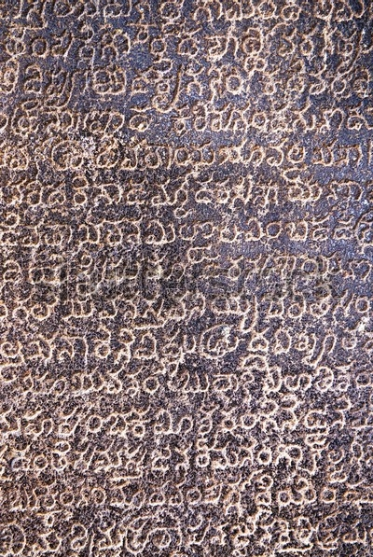
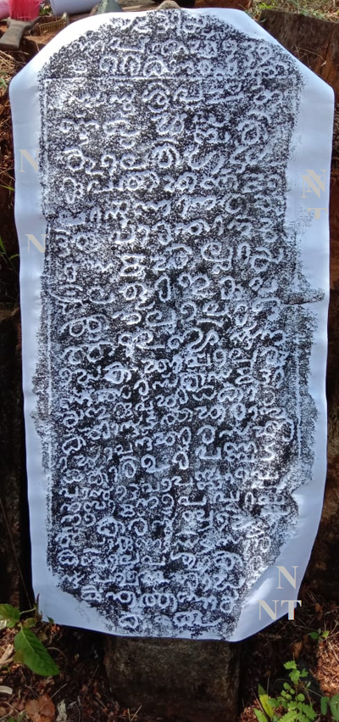
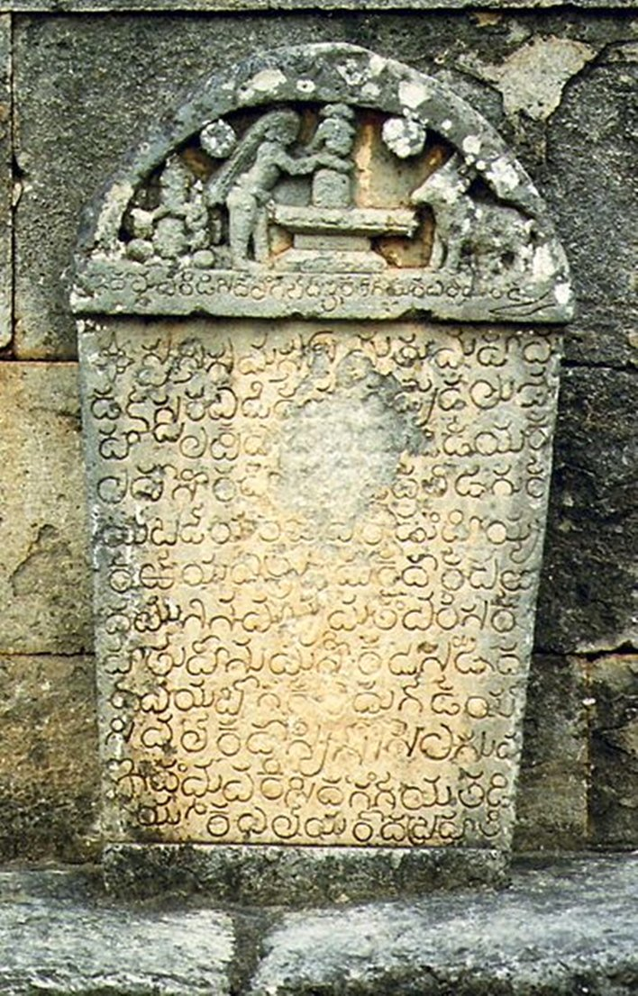
IMAGES OF DAMAGED ANCIENT MANUSCRIPTS FOUND ON THE INTERNET

Slide 8
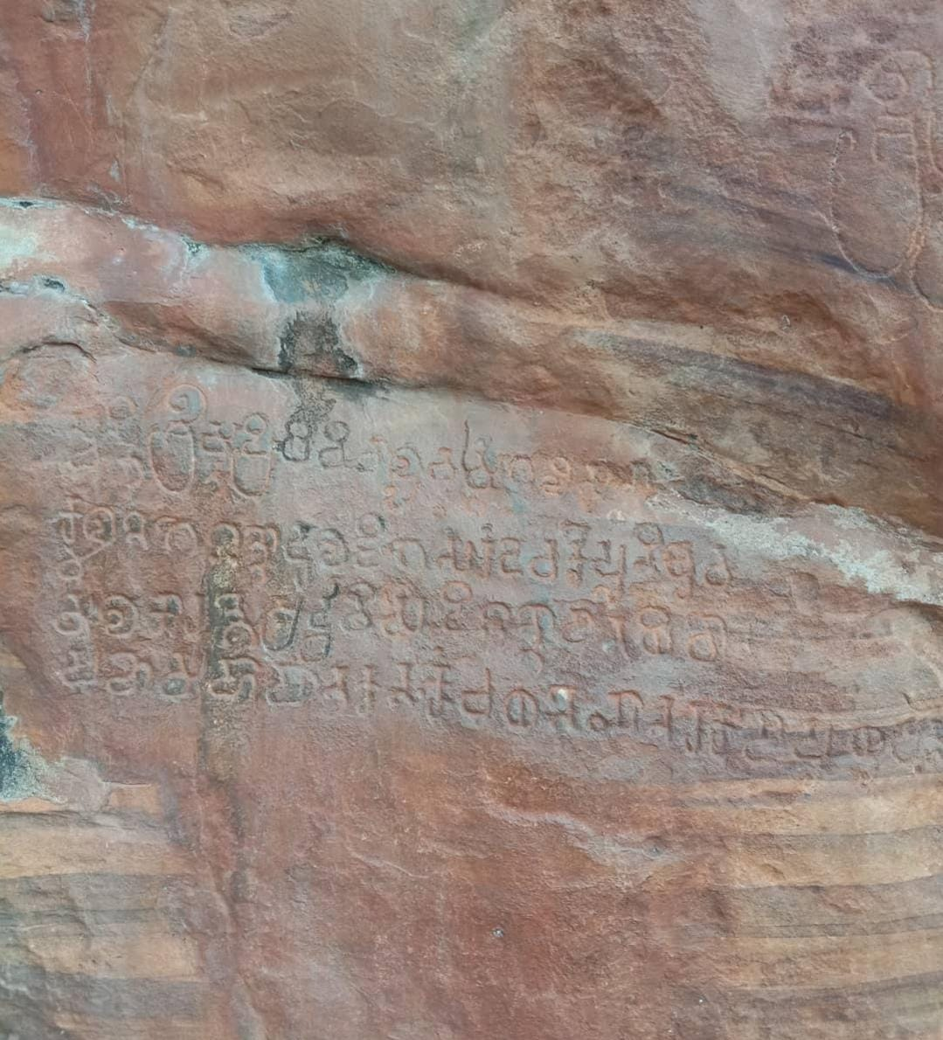
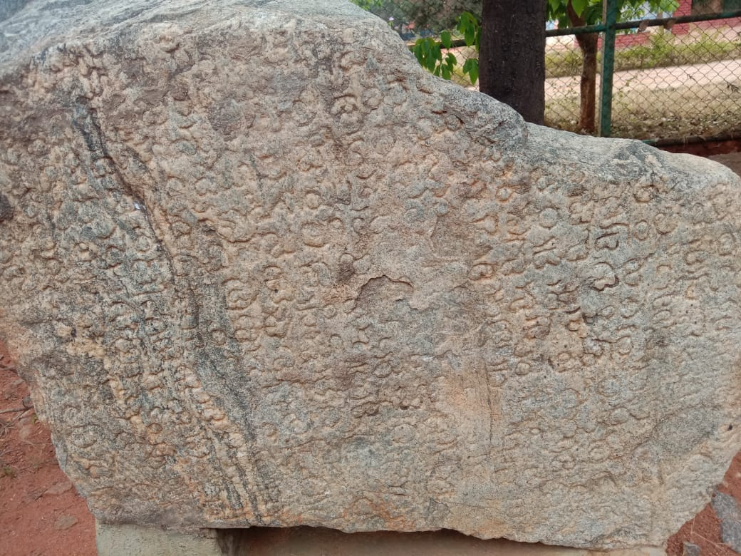
CAPTURED BY MOBILE PHONE

Slide 9
WORK DONE
BACKGROUND NORMALISATION
The background normalization algorithms are designed for normalizing pixel intensities of gray scale document images. It is designed to adaptively adjust the pixel intensity based on an approximation of the background of a document image. The approximation is done along each scanline of an image. Along the scanline, first filter the pixels to leave behind only those that belong to the background

Slide 10
WORK DONE(CONT’D)
HISTOGRAM EQUALISATION
Histogram Equalization is a computer image processing technique used to improve contrast in images. It accomplishes this by effectively spreading out the most frequent intensity values, i.e. stretching out the intensity range of the image.

Slide 11
WORK DONE(CONT’D)
K-MEANS ALGORITHM
The basic idea of K-means algorithm is to cluster the objects closest to them by clustering the K points in the space. It takes the distance from the data point to the prototype as the objective function of optimization. The K-means algorithm takes Euclidean distance as the similarity measure, which is to find the optimal classification of an initial cluster center vector

Slide 12
REFERENCES
S. R. Yahya, S. N. H. S. Abdullah, K. Omar, M. S. Zakaria and C. Y. Liong, "Review on image enhancement methods of old manuscript with the damaged background," 2009 International Conference on Electrical Engineering and Informatics, 2009, pp. 62-67, doi: 10.1109/ICEEI.2009.5254816
A. Gupta, S. Kumar, R. Gupta, S. Chaudhury and S. Joshi, "Enhancement of Old Manuscript Images," Ninth International Conference on Document Analysis and Recognition (ICDAR 2007), 2007, pp. 744-748, doi: 10.1109/ICDAR.2007.4377014.
Zhixin Shi and Venu Govindaraju ,“Historical Handwritten Document Image Segmentation Using Background Light Intensity Normalization” ,Center of Excellence for Document Analysis and Recognition (CEDAR), State University of New York at Buffalo, Amherst, USA. January17, 2005.
Zhixin Shi Srirangaraj Setlur ,Venu Govindaraju “Digital Image Enhancement using Normalization Techniques and their application to Palm Leaf Manuscripts”, Center of Excellence for Document Analysis and Recognition(CEDAR), February 21, 2005.
P. J.N.Kapur and A.K.C.Wong, “A new method for gray- level picture thresholding using the entropy of the histogram”, Computer Vision, Graphics, and Image Processing, vol. 29, pp.273{285, 1985}, March 1985.

